Slide 1
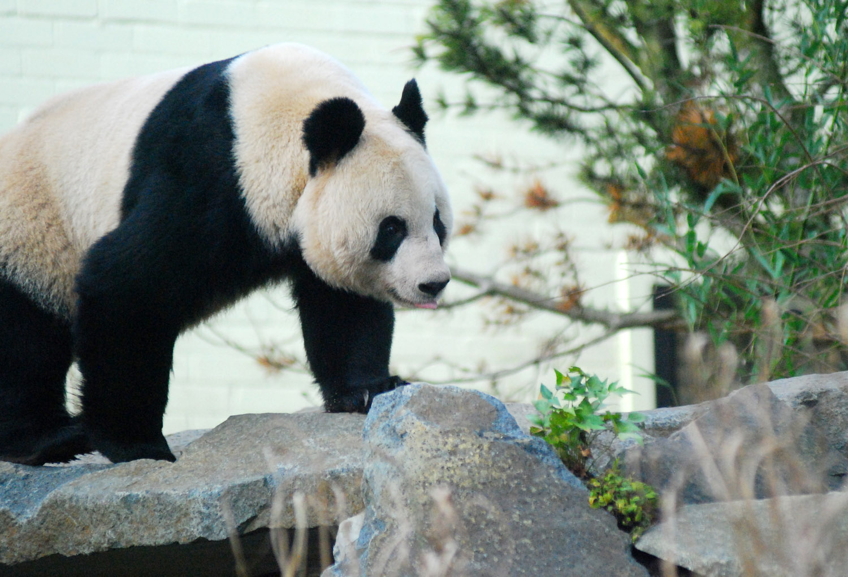
CfE IDL/ Topic Planner for A Giant Farewell

Slide 2
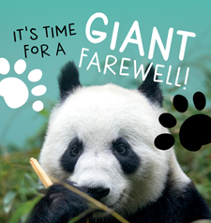
A Giant Farewell – SECOND LEVEL
Experiences and Outcomes
Literacy and Language
LIT 2-02a
Numeracy
MNU 2-11a
Expressive Arts
EXA 2-03a
Social Studies
SCN 2-01a
Science
SOC 2-08a
LIT2-05a
LIT 2-07a
LIT2-11a
LIT 2-14a/2-15a
LIT 1-20a/LIT 2-20a
LIT 2-24a
MTH 2-12a
MNU 2-20a
MNU 2-20b
EXA 2-13a
EXA 2-14a
SCN 2-02a
SCN 2-12b
SCN 2-14a
SCN 2-14b
SCN 2-20b
SOC 2-12a
SOC 2-16c
Wider links
LfS – Goals 13 (Climate Action), Goal 15 (Life on Land), Goal 4 (Quality Education)
UNCRC – Article 13, Article 17, article 28, Article 29

Slide 3
A Giant Farewell – SECOND LEVEL
Suggested Activities
Literacy and Language
Local legends around Panda, Snow Leopard
Numeracy
Estimation – panda growth mass and length
Expressive Arts
Bamboozled play – available on request.
Social Studies
Classification – compare and contrast giant vs red panda
Science
Human impact on habitats (climate change, fragmentation, deforestation)
Non-chronological reports and fact files
Han Pai Poetry
Story Mapping
Estimation – diet and bamboo
Venn diagrams – Habitats, species, predators and prey
Panda Growth Line Chart
Webcam Behaviour observation – Tally
Genetic Inheritance – Carroll Diagram.
Panda Diet Pie Chart
Calligraphy and ink arts.
Willow Pattern Plate design
Printed materials (silks)
Paper folding
Chinese court fan design
Pandas and their neighbours
Panda Food Chains and webs
Genetics and inheritance
Shadow puppetry.
Compare and contrast celtic forest to Chinese Fir Forests.
Map reading – topography, distribution
Beyond the Panda – language learning.
Links to supporting ZOOdle Resources:
  https://learning.rzss.org.uk/course/view.php?id=219 – Our Giant Farewell Hub!
  https://learning.rzss.org.uk/course/view.php?id=128 – Panta-tastic
  https://learning.rzss.org.uk/course/view.php?id=21 – Beyond the Panda 1+2 MfL resources

Slide 4
A Giant Farewell – First LEVEL
Experiences and Outcomes
Literacy and Language
LIT 2-02a
Numeracy
MNU 1-01a
Expressive Arts
EXA 1-08a
Social Studies
SCN 2-01a
Science
SOC 2-08a
LIT2-05a
LIT 2-07a
LIT2-11a
LIT 2-14a/2-15a
LIT 1-20a/LIT 2-20a
LIT 2-24a
SCN 2-02a
SCN 2-12b
SCN 2-14a
SCN 2-14b
SCN 2-20b
SOC 2-12a
SOC 2-16c
EXA 1-05a
EXA 1-02a
MNU 1-03a
MNU 1-07a/c
MNU 1-11a/b
Wider links
LfS – Goals 13 (Climate Action), Goal 15 (Life on Land), Goal 4 (Quality Education)
UNCRC – Article 13, Article 17, article 28, Article 29

Slide 5
A Giant Farewell – First LEVEL
Suggested Activities
Literacy and Language
Numeracy
Counting games and “counting bears” as concrete resources to support. Learning.
Expressive Arts
Bamboozled play – available on request.
Social Studies
Classification – compare and contrast giant vs red panda
Science
Human impact on habitats (climate change, fragmentation, deforestation)
Dance – mimic panda moves (handstand, roly polly, climb, crawl).
Calligraphy and ink arts.
Pandas and their neighbours
Panda Food Chains and webs
Genetics and inheritance
Shadow puppetry.
Compare and contrast Celtic forest to Chinese Fir Forests.
Map reading – topography, distribution
Local legends around Panda, Snow Leopard
Story Mapping
Non-chronological reports and fact files
Panda Cup Cakes : recipes and quantities
Willow Plate design.
Animal Sketching/collages
Fractions – dividing Panda Cake (like a giant dumpling).
Draw out a panda and measure using formal and informal units.
Panda Cup Cakes
Links to supporting ZOOdle Resources:
  https://learning.rzss.org.uk/course/view.php?id=219 – Our Giant Farewell Hub!
  https://learning.rzss.org.uk/course/view.php?id=128 – Panta-tastic
  https://learning.rzss.org.uk/course/view.php?id=21 – Beyond the Panda 1+2 MfL resources

Slide 6
A Giant Farewell – EARLY LEVEL
Experiences and Outcomes
Literacy and Language
LIT 0-01c
Numeracy
MNU 0-01a
Expressive Arts
Health and Wellbeing
SCN 0-01a
Science and Social Studies
HWB 0-27a
EXA 0-02a
LIT 0-04a
LIT 0-09b/LIT 0-31a
LIT 0-07a/LIT 0-016a/ENG 0-17a
LIT 0-19a
MNU 0-03a
MNU 0-11a
MTH 0-19a
HWB 0-51a
EXA0-04a
EXA 0-05a
EXA 0-08a
SCN 0-20a
SOC 0-09a
Wider links
LfS – Goals 13 (Climate Action), Goal 15 (Life on Land), Goal 4 (Quality Education)
UNCRC – Article 13, Article 29, Article 31

Slide 7
A Giant Farewell – EARLY LEVEL
Suggested Activities
Literacy and Language
Numeracy and Maths
Counting games and “counting bears” as concrete resources to support awareness of cardinal value
Expressive Arts
Bamboozled play – available on request.
Health and Wellbeing
Science and Social Studies
Living and Non-living – tough tray sort and exploration using feathers/fur/leaves/ pinecones/rocks/toys
Panda Yoga/Movement
Dance – mimic panda moves (handstand, roly polly, climb, crawl).
Calligraphy and ink arts.
Story telling – a Giant Adventure (see online resource)
Willow Plate design.
Animal Sketching/collages
Panda Cake Baking – using edible or salt dough recipes.
Symmetry in nature – using animal faces and patterns.
Going on a Bear hunt – Michael Rosen links
Please Mr Panda – story telling
Lucky Bamboo- story telling.
Panda Diet – eating fruits/veg/bamboo shoots and slices
Taking care of a baby - needs and requirements, using video of baby panda or teddies as stimulus.
How the panda’s came to Scotland – see Pandatastic.
Growing Bamboo – propagate from cuttings.
Make a loose parts den.
Links to supporting ZOOdle Resources:
  https://learning.rzss.org.uk/course/view.php?id=219 – Our Giant Farewell Hub!
  https://learning.rzss.org.uk/course/view.php?id=128 – Panta-tastic
  https://learning.rzss.org.uk/course/view.php?id=21 – Beyond the Panda 1+2 MfL resources

