Slide 1
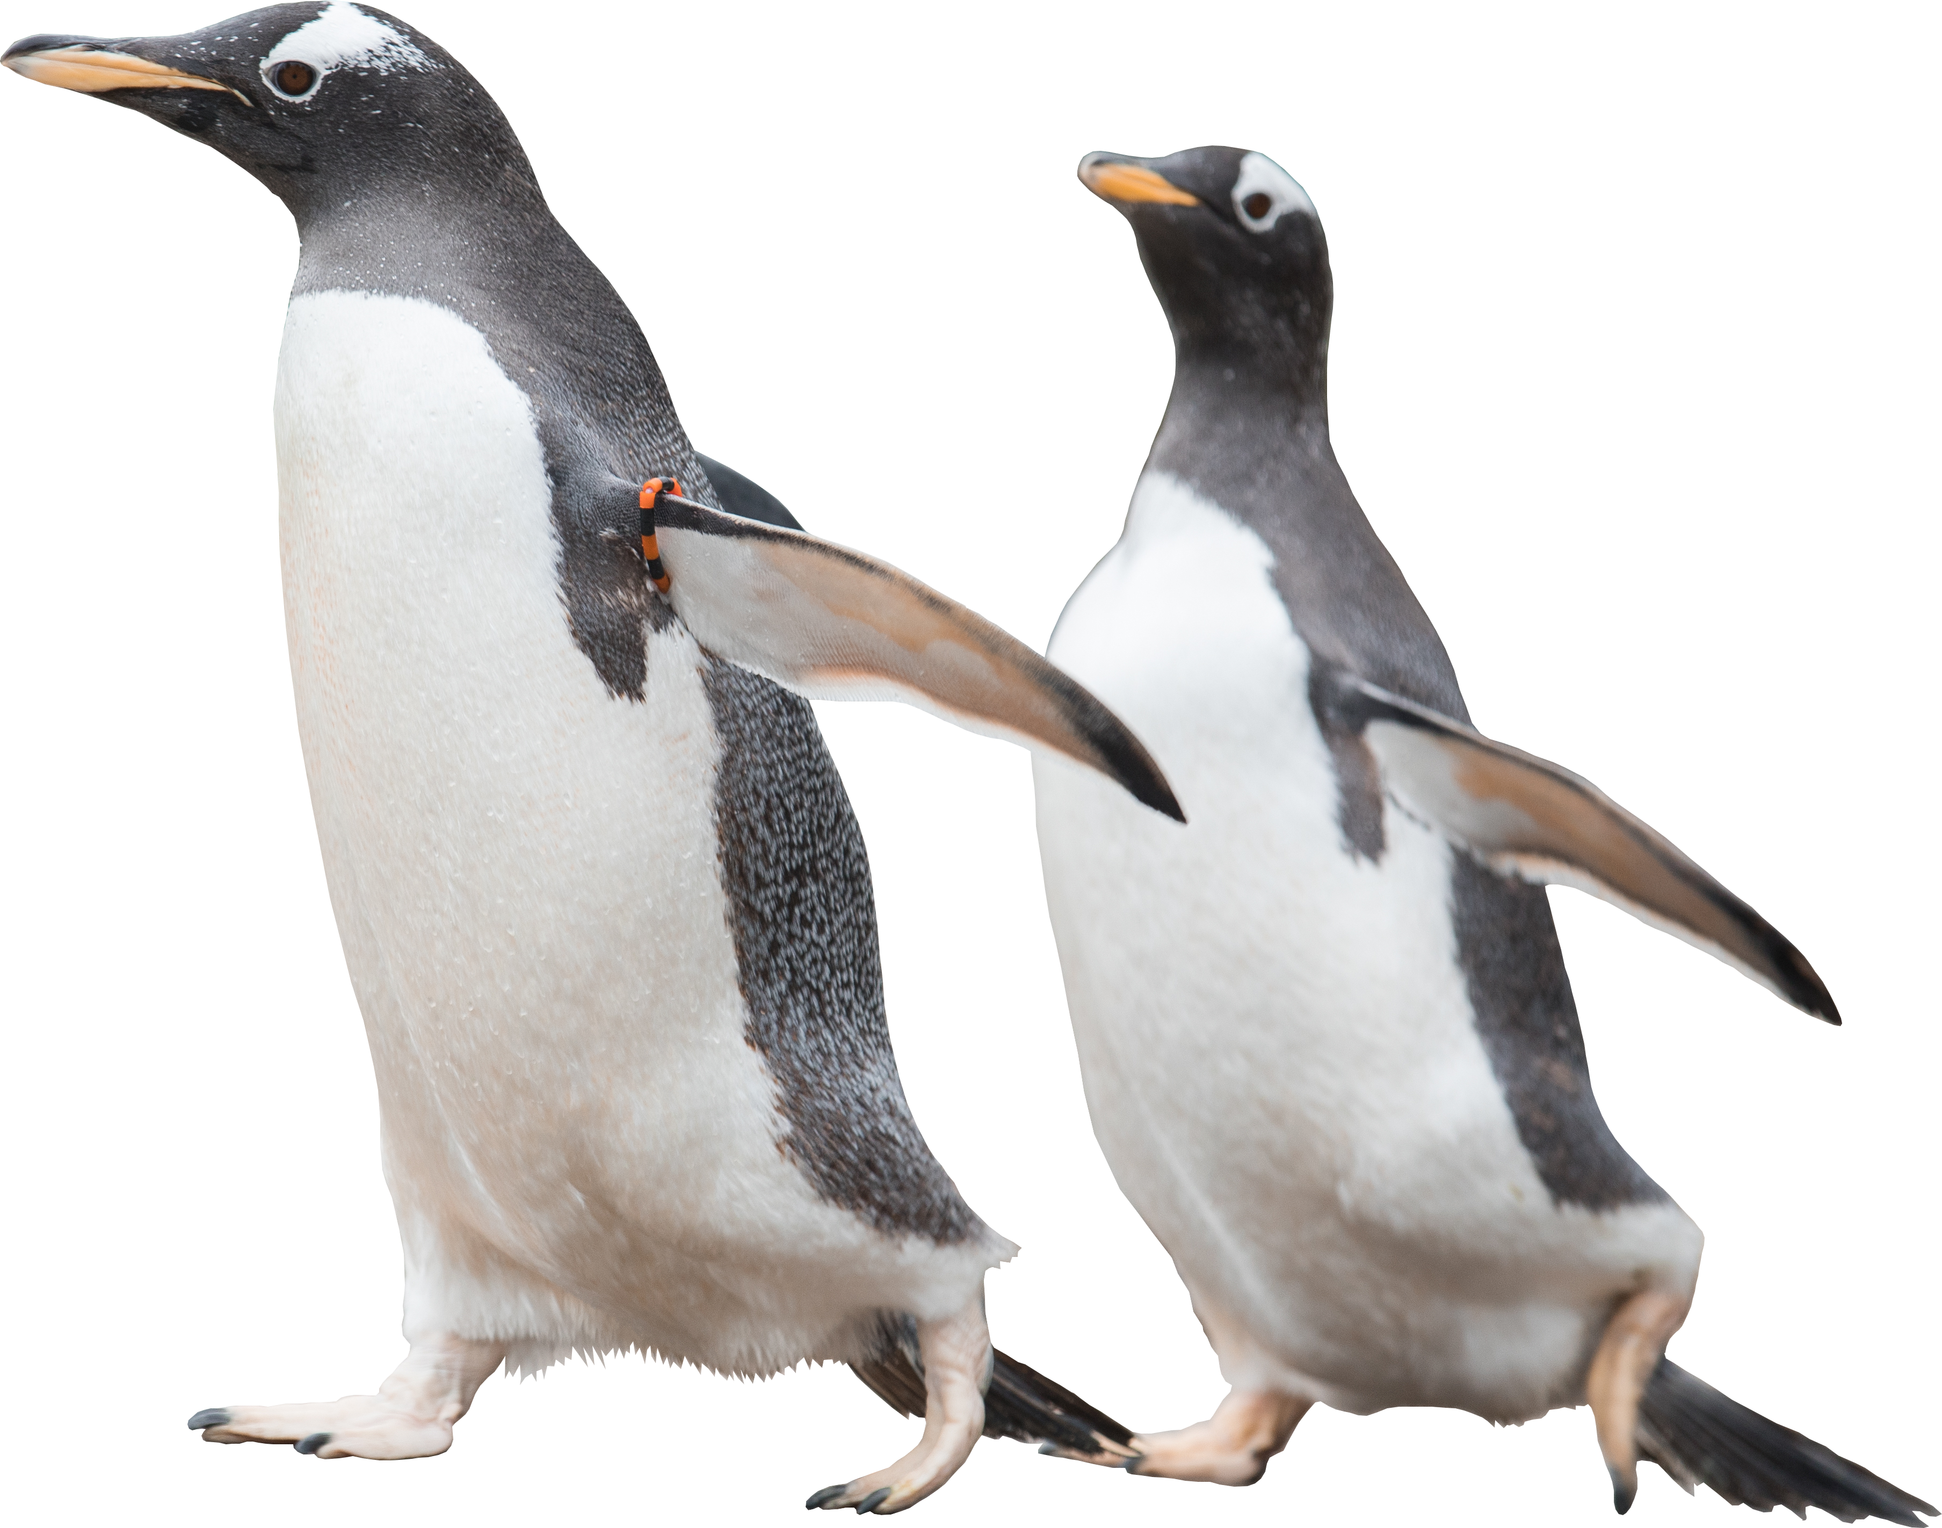
RZSS Zoo Studies
Converting Onsite Learning
to Online Learning
Notes:
Main title slide
To be used at the beginning of the presentation, and can be used as a header to break up sections if needed.
Feel free to swap the penguins for another animal or remove entirely! (animals can be found on slide X)

Slide 2
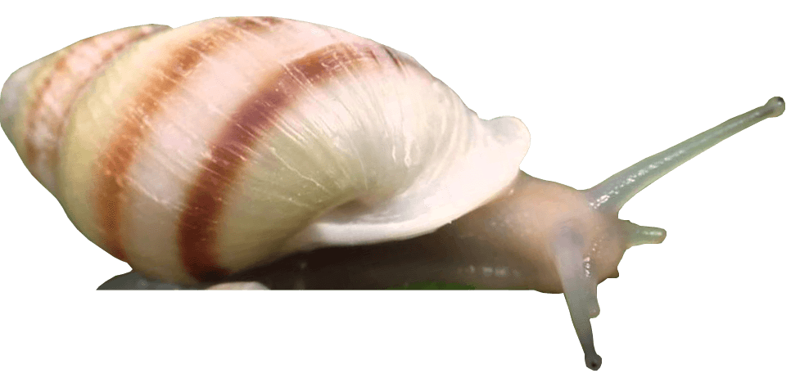
Science Summer School & ZEBRA Programmes
The Good Old Days Onsite:
150 Placements Per year
Notes:
Images with a title
Large images should be full screen with the overlay where possible, but if a title is needed, the image should keep within the borders of the logo, in the dimensions demonstrated above.
Can also add bubbles with keywords to this layout.

Slide 3
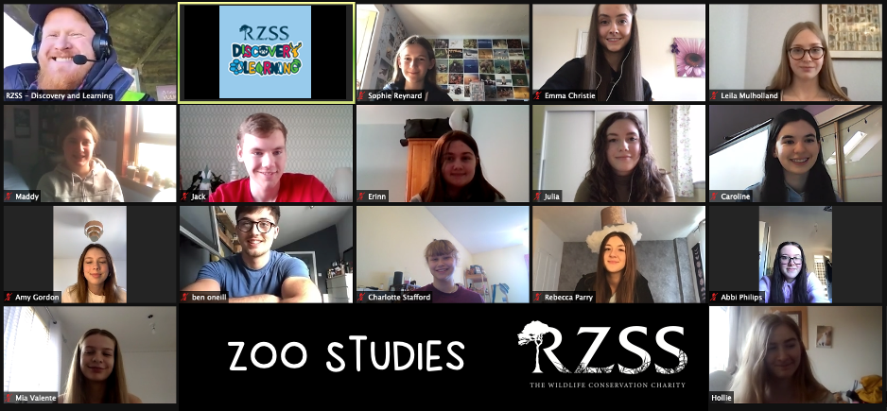
2020-2021: The Move Online
Notes:
Full width image grid with a title
Sized as required.
Best not to use bubbles with an image grid as it can be quite visually busy anyway!

Slide 4
Welcome to
ZOOdle
5 Days
Of Interactive Online Activities, Games, Quizzes & More!

Slide 5
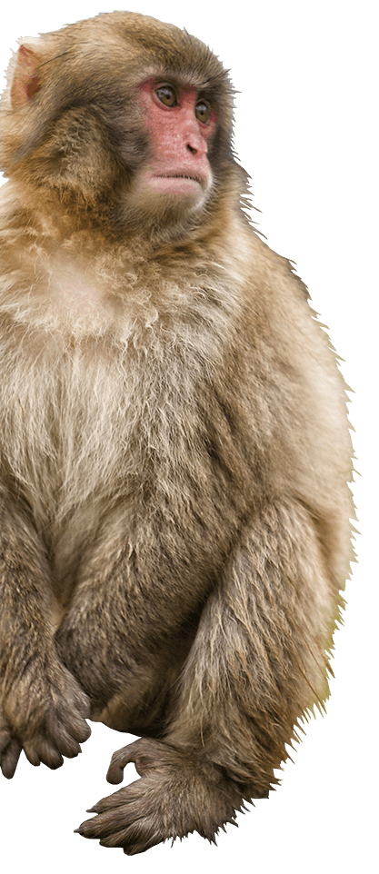
To Earn a ZEBRA Award Online…
Behavioural Research Task Evidence:
Assessment 1: Visual Representation of Data (e.g. Graphs)
Assessment 2: Project Abstract (300 words)
Additional Creative Zoo Design Tasks:
Assessment 3: Enrichment Design
Assessment 4: Enclosure Design
Assessment 5: Interpretation Design
Notes:
Bullet points
You can copy this text box to get the pawprint bullet points,
or you can go to this image: https://learning.rzss.org.uk/pluginfile.php/911/block_html/content/navyBullet.svg (right click to save as)
Go to bullets, bullets and numbering, and picture….

Slide 6
Feedback and Impact
Total
Learners:
113
£4437.50 income to our charity
98 ZEBRA Awards Issued by RZSS over Lockdowns
58% Had Never Researched Animals Before
Rated 9.4 / 10 For Value for Money
Rated 9.6 / 10 For Usefulness
New Audiences: - 18% Never Visited EZ.
- 51% Never Visited HWP.
- 1 Never Visited ANY Zoo!
Pass Rate:
85%
595
Unique Online Engagements Per Learner
11%
Increase In Learner Nature Connectedness
(NCI)
Notes:
Bubbles
INS = 10.9% Increase
NCI = 11.3% Increase

Slide 7
RZSS’s Three Animals Test
Pre- and Post-: “From 1 to 10, how emotionally connected are you to…?”
“Mowgli the Jaguar”
Not Mentioned
Not Studied
“Rotana the Sun Bear”
Mentioned
Not Studied
“Snowflake the Gentoo”
Mentioned
Studied
7%
15%
22%

Slide 8
Online to Onsite Comparison
Less Impact on Nature Connectedness Scores:
Online Zoo Studies Has Good Impact
Onsite Science Summer School shows Statistically Significant Improvement to both INS and NCI scores
Online Numbers Reducing:
Spring 2021: 56 Bookings.
Summer 2021: 27 Bookings
A 52% Drop. Are People ZOOM’d Out?
Fewer Learners Reach ‘The End’:
100% of Students Complete Onsite Week.
Only 85% Complete Online Zoo Studies Week (69% Summer ‘21)
 | Mean NCI Scores |  | Mean INS Scores
 | Online (Zoo Studies) | Onsite (Science Summer School) | Online (Zoo Studies) | Onsite (Science Summer School)
Pre- Scores | 67.18 | 63.23 | 4.68 | 4.65
Post- Scores | 74.75 | 68.72 | 5.12 | 5.00
% Increase | 11.3% | 8.7% | 9.4% | 7.5%
P-Value (After Paired T-Test) | 0.094 (Insignificant) | 0.014* (Significant) | 0.0002* (Significant) | 0.012* (Significant)

Slide 9
Calculate Your Own Nature Connectedness Index (NCI)
Question: | Response Scale Rating Statement
Question: | Completely Disagree | Strongly Disagree | Disagree | Neither Agree nor Disagree | Agree | Strongly Agree | Completely Agree | Score
I always find beauty in nature | 0 | 1 | 2 | 3 | 5 | 9 | 15
I always treat nature with respect | 0 | 0 | 1 | 2 | 4 | 6 | 10
Being in nature makes me very happy | 0 | 1 | 2 | 3 | 6 | 10 | 16
Spending time in nature is very important to me | 0 | 1 | 2 | 3 | 6 | 11 | 19
I find being in nature really amazing | 0 | 1 | 2 | 3 | 6 | 10 | 17
I feel part of nature | 0 | 1 | 2 | 4 | 7 | 13 | 23
Total (Average = 61):
(Richardson et al 2019)

Slide 10
Calculate Your Own Nature Connectedness Index (NCI)
Question: | Response Scale Rating Statement
Question: | Completely Disagree | Strongly Disagree | Disagree | Neither Agree nor Disagree | Agree | Strongly Agree | Completely Agree | Score
I always find beauty in nature | 0 | 1 | 2 | 3 | 5 | 9 | 15
I always treat nature with respect | 0 | 0 | 1 | 2 | 4 | 6 | 10
Being in nature makes me very happy | 0 | 1 | 2 | 3 | 6 | 10 | 16
Spending time in nature is very important to me | 0 | 1 | 2 | 3 | 6 | 11 | 19
I find being in nature really amazing | 0 | 1 | 2 | 3 | 6 | 10 | 17
I feel part of nature | 0 | 1 | 2 | 4 | 7 | 13 | 23
Total (Average = 61):
(Richardson, et al. 2019)

Slide 11
Calculate Your Own Inclusion of Nature In Self (INS)
Next Activity:
Go to: Menti.com
(use a different device)
Type code: 9665 0094
(Shultz, 2002. Source: Wikimedia Commons)

Slide 12
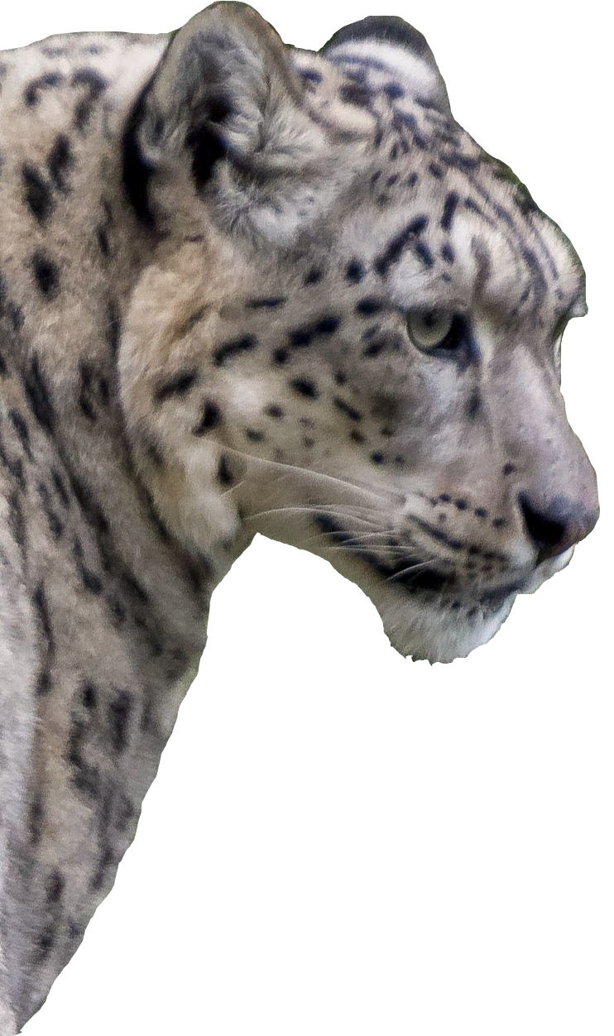
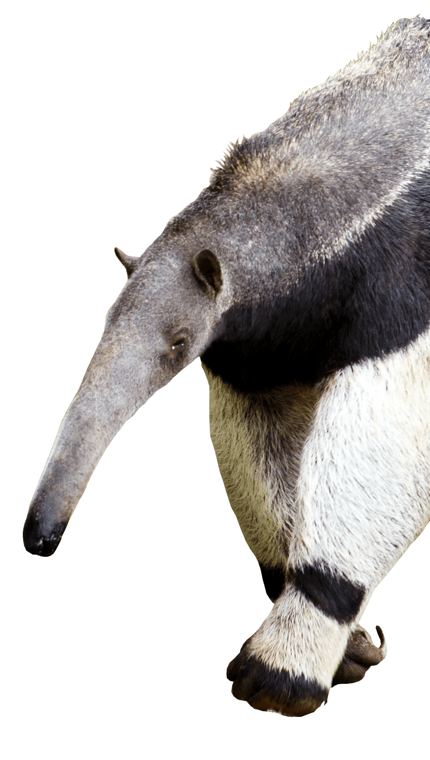
Go to: Menti.com
Type code: 9665 0094
Blair Cockburn,
Lizzie Seymour & Jasper Hughes
Education Officer at RZSS Edinburgh Zoo
bcockburn@rzss.org.uk

