Slide 1
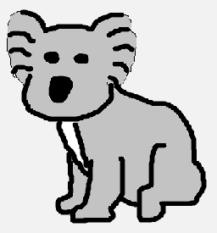

I Walkabout for Koalas
Continue

Slide 2


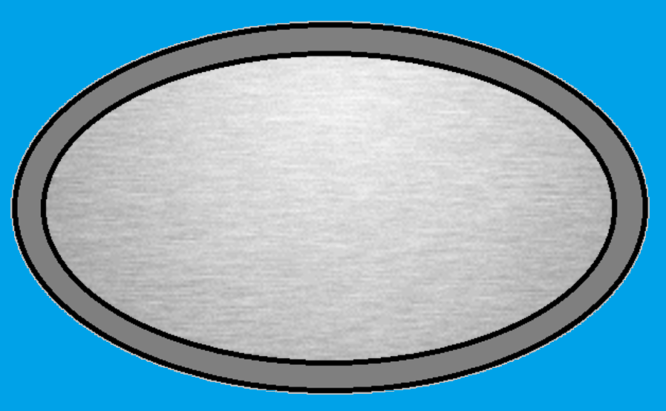
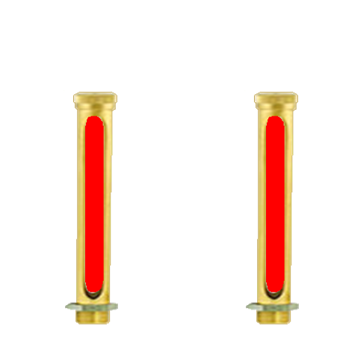

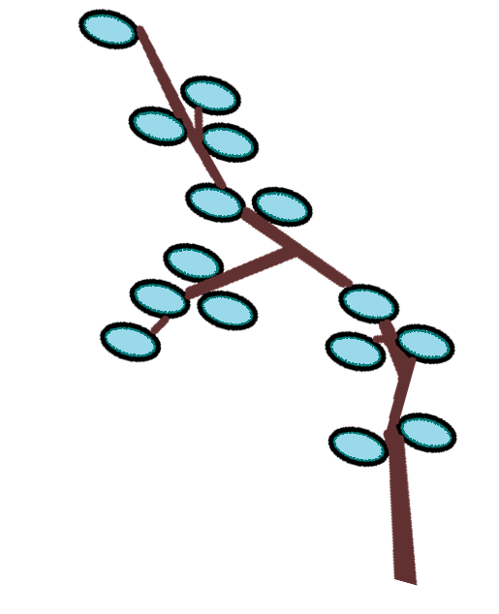
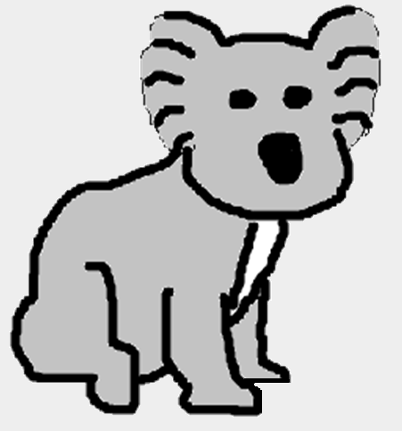
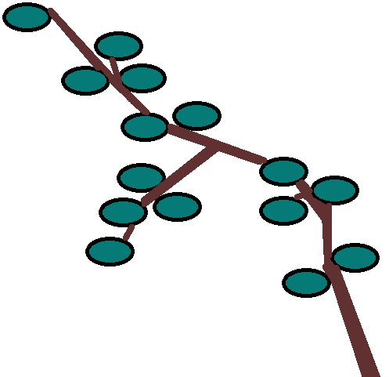
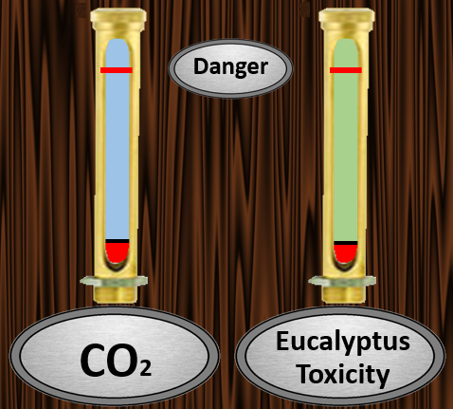
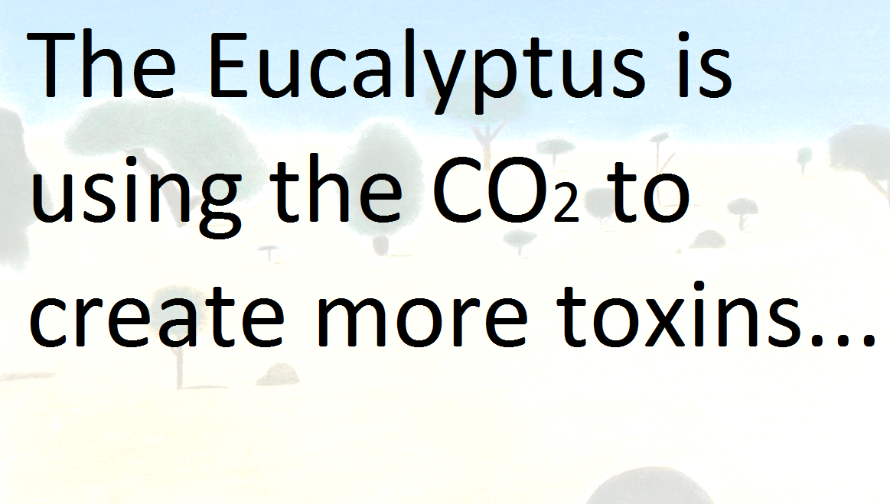
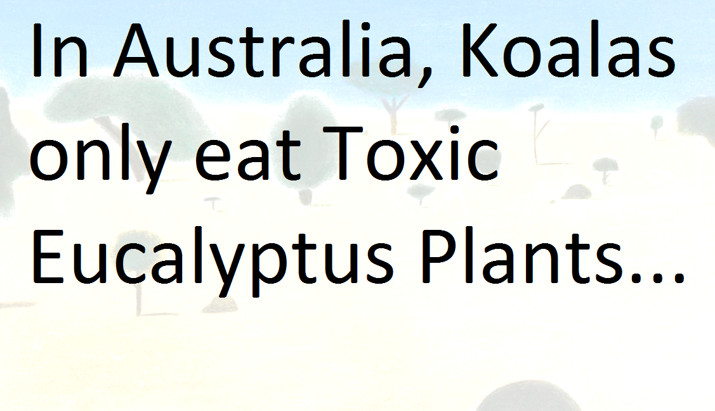
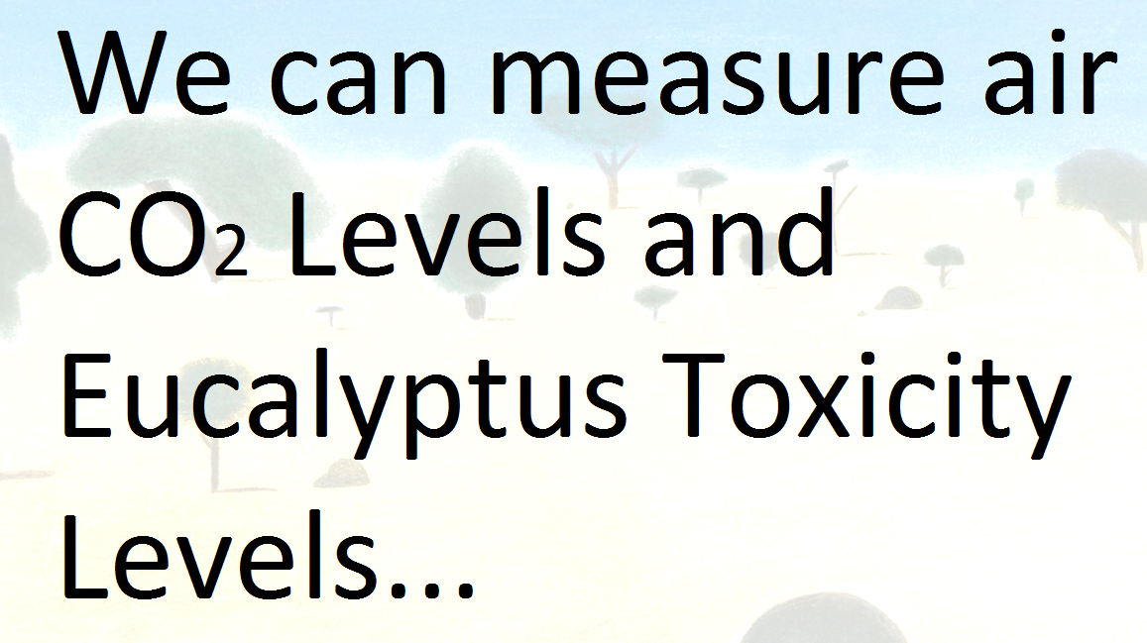
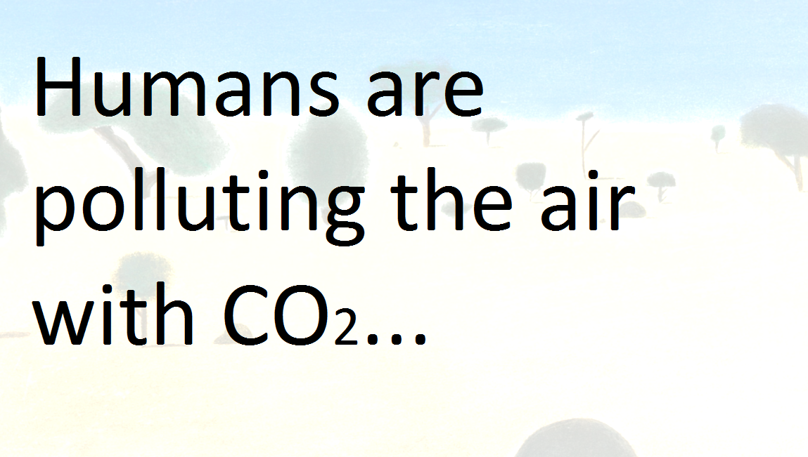
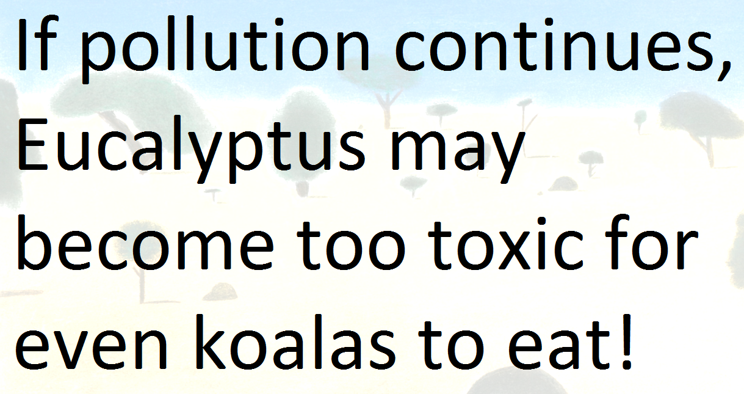

1
1
2
3
4
5
Tutorial
2
3
4
5
Continue

Slide 3

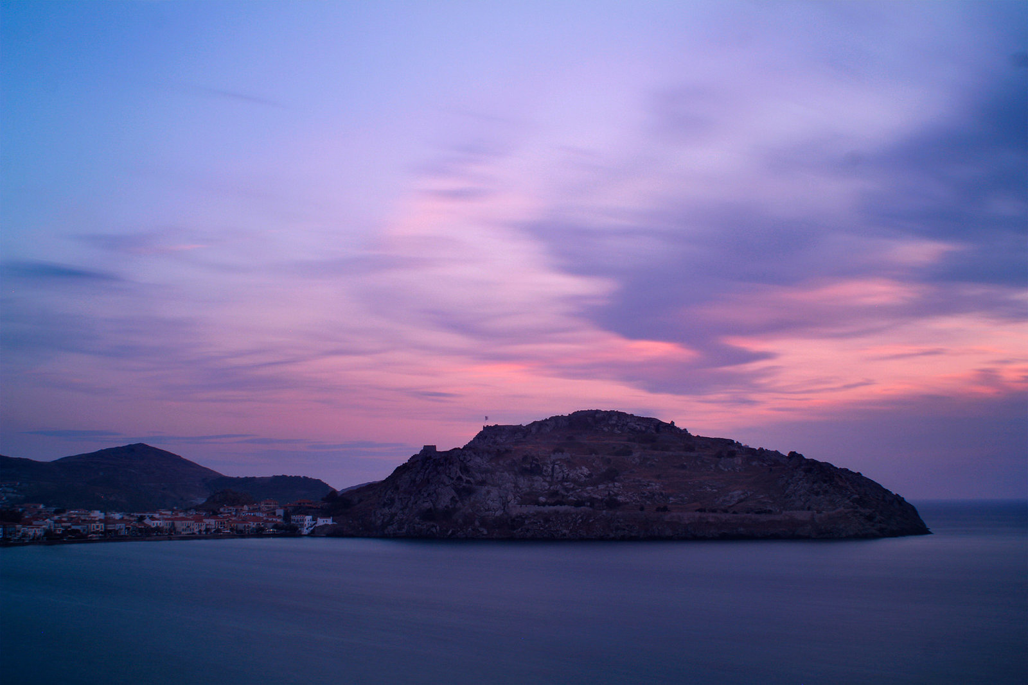
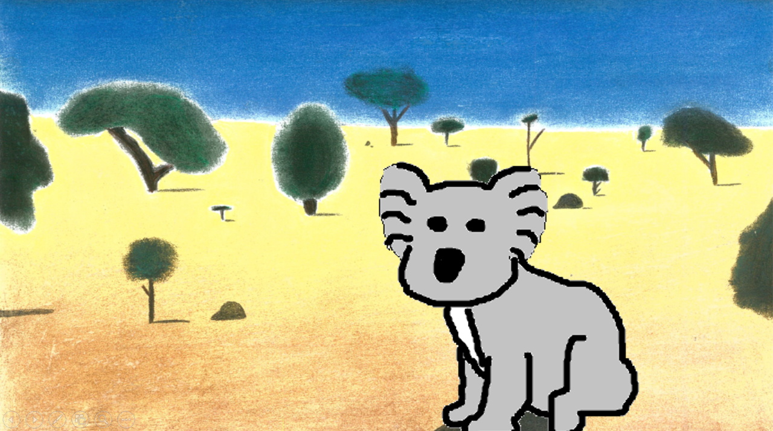

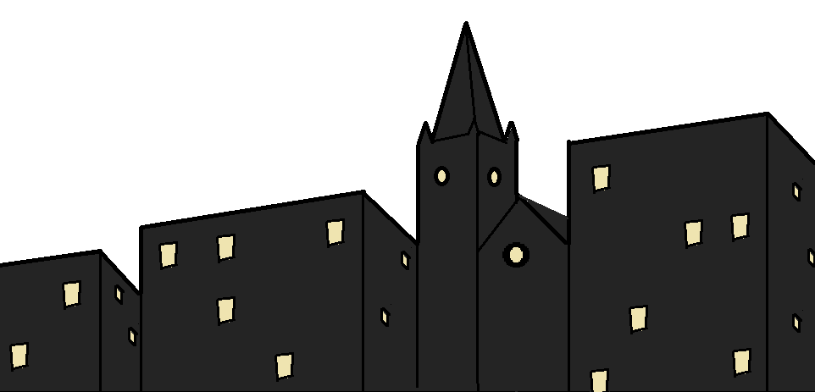

What Would You do?
What would you do?
Our Actions in Scotland can effect Koalas in Australia.
Make lifestyle choices to save the koala from extinction!
Danger
Start Game
CO2
Eucalyptus Toxicity

Slide 4

What Would You do?
What would you do?
It’s a cold, wet winter’s morning. How will you get to school?
Danger
Car
Bicycle or Walk
CO2
Eucalyptus Toxicity

Slide 5
What Would You do?
What would you do?
You go to the kitchen one night to get a drink. As you leave the room, what do you do?
Danger
Switch Off Light
Leave Light On
(you might go back in soon)
CO2
Eucalyptus Toxicity

Slide 6
What Would You do?
What would you do?
You go to the kitchen one night to get a drink. As you leave the room, what do you do?
Danger
Switch Off Light
Leave Light On
(you might go back in soon)
CO2
Eucalyptus Toxicity

Slide 7
What Would You do?
What would you do?
The batteries in the TV remote have died. Where do they go?
Danger
Rubbish Bin
Recycling
CO2
Eucalyptus Toxicity

Slide 8
What Would You do?
What would you do?
The batteries in the TV remote have died. Where do they go?
Danger
Rubbish Bin
Recycling
CO2
Eucalyptus Toxicity

Slide 9
What Would You do?
What would you do?
The batteries in the TV remote have died. Where do they go?
Danger
Rubbish Bin
Recycling
CO2
Eucalyptus Toxicity

Slide 10
What Would You do?
What would you do?
The batteries in the TV remote have died. Where do they go?
Danger
Rubbish Bin
Recycling
CO2
Eucalyptus Toxicity

Slide 11
What Would You do?
What would you do?
You are in your house in summer and feeling too hot, what do you do?
Danger
Open a Window
Open Freezer Door & Stand in Front
CO2
Eucalyptus Toxicity

Slide 12
What Would You do?
What would you do?
You are in your house in summer and feeling too hot, what do you do?
Danger
Open a Window
Open Freezer Door & Stand in Front
CO2
Eucalyptus Toxicity

Slide 13
What Would You do?
What would you do?
You are in your house in summer and feeling too hot, what do you do?
Danger
Open a Window
Open Freezer Door & Stand in Front
CO2
Eucalyptus Toxicity

Slide 14
What Would You do?
What would you do?
You are in your house in summer and feeling too hot, what do you do?
Danger
Open a Window
Open Freezer Door & Stand in Front
CO2
Eucalyptus Toxicity

Slide 15
What Would You do?
What would you do?
You are in your house in summer and feeling too hot, what do you do?
Danger
Open a Window
Open Freezer Door & Stand in Front
CO2
Eucalyptus Toxicity

Slide 16
What Would You do?
What would you do?
You are in your house in summer and feeling too hot, what do you do?
Danger
Open a Window
Open Freezer Door & Stand in Front
CO2
Eucalyptus Toxicity

Slide 17
What Would You do?
What would you do?
Before bed, you brush your teeth. Which tap do you use?
Danger
Cold Tap
Hot Tap
CO2
Eucalyptus Toxicity

Slide 18
What Would You do?
What would you do?
Before bed, you brush your teeth. Which tap do you use?
Danger
Cold Tap
Hot Tap
CO2
Eucalyptus Toxicity

Slide 19
What Would You do?
What would you do?
Before bed, you brush your teeth. Which tap do you use?
Danger
Cold Tap
Hot Tap
CO2
Eucalyptus Toxicity

Slide 20
What Would You do?
What would you do?
Before bed, you brush your teeth. Which tap do you use?
Danger
Cold Tap
Hot Tap
CO2
Eucalyptus Toxicity

Slide 21
What Would You do?
What would you do?
Before bed, you brush your teeth. Which tap do you use?
Danger
Cold Tap
Hot Tap
CO2
Eucalyptus Toxicity

Slide 22
What Would You do?
What would you do?
Before bed, you brush your teeth. Which tap do you use?
Danger
Cold Tap
Hot Tap
CO2
Eucalyptus Toxicity

Slide 23
What Would You do?
What would you do?
Before bed, you brush your teeth. Which tap do you use?
Danger
Cold Tap
Hot Tap
CO2
Eucalyptus Toxicity

Slide 24

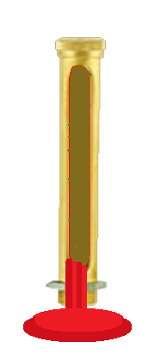
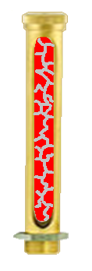
What Would You do?
What would you do?
What Happened?
Danger
CO2
Eucalyptus Toxicity

Slide 25
What Would You do?
What would you do?
You wake in the morning feeling cold. What do you do?
Danger
Turn on a Heater
Put on More Layers
CO2
Eucalyptus Toxicity

Slide 26
What Would You do?
What would you do?
You wake in the morning feeling cold. What do you do?
Danger
Turn on a Heater
Put on More Layers
CO2
Eucalyptus Toxicity

Slide 27
What Would You do?
What would you do?
You wake in the morning feeling cold. What do you do?
Danger
Turn on a Heater
Put on More Layers
CO2
Eucalyptus Toxicity

Slide 28
What Would You do?
What would you do?
You wake in the morning feeling cold. What do you do?
Danger
Turn on a Heater
Put on More Layers
CO2
Eucalyptus Toxicity

Slide 29
What Would You do?
What would you do?
You wake in the morning feeling cold. What do you do?
Danger
Turn on a Heater
Put on More Layers
CO2
Eucalyptus Toxicity

Slide 30
What Would You do?
What would you do?
You wake in the morning feeling cold. What do you do?
Danger
Turn on a Heater
Put on More Layers
CO2
Eucalyptus Toxicity

Slide 31
What Would You do?
What would you do?
You wake in the morning feeling cold. What do you do?
Danger
Turn on a Heater
Put on More Layers
CO2
Eucalyptus Toxicity

Slide 32
What Would You do?
What would you do?
What Happened?
Danger
CO2
Eucalyptus Toxicity

Slide 33
What Would You do?
What would you do?
On the way to school, you stop to buy a cola. There are two types available, one big name American brand and a local brand you had not heard of. Which do you buy?
Danger
Expensive Local Brand Cola
Cheaper, American Brand Cola
CO2
Eucalyptus Toxicity

Slide 34
What Would You do?
What would you do?
On the way to school, you stop to buy a cola. There are two types available, one big name American brand and a local brand you had not heard of. Which do you buy?
Danger
Expensive Local Brand Cola
Cheaper, American Brand Cola
CO2
Eucalyptus Toxicity

Slide 35
What Would You do?
What would you do?
On the way to school, you stop to buy a cola. There are two types available, one big name American brand and a local brand you had not heard of. Which do you buy?
Danger
Expensive Local Brand Cola
Cheaper, American Brand Cola
CO2
Eucalyptus Toxicity

Slide 36
What Would You do?
What would you do?
On the way to school, you stop to buy a cola. There are two types available, one big name American brand and a local brand you had not heard of. Which do you buy?
Danger
Expensive Local Brand Cola
Cheaper, American Brand Cola
CO2
Eucalyptus Toxicity

Slide 37
What Would You do?
What would you do?
On the way to school, you stop to buy a cola. There are two types available, one big name American brand and a local brand you had not heard of. Which do you buy?
Danger
Expensive Local Brand Cola
Cheaper, American Brand Cola
CO2
Eucalyptus Toxicity

Slide 38
What Would You do?
What would you do?
On the way to school, you stop to buy a cola. There are two types available, one big name American brand and a local brand you had not heard of. Which do you buy?
Danger
Expensive Local Brand Cola
Cheaper, American Brand Cola
CO2
Eucalyptus Toxicity

Slide 39
What Would You do?
What would you do?
On the way to school, you stop to buy a cola. There are two types available, one big name American brand and a local brand you had not heard of. Which do you buy?
Danger
Expensive Local Brand Cola
Cheaper, American Brand Cola
CO2
Eucalyptus Toxicity

Slide 40
What Would You do?
What would you do?
What Happened?
Danger
CO2
Eucalyptus Toxicity

Slide 41


Well Done!
The Species Survived!
Play Again?

Slide 42
Well Done!
The Species Survived!
Play Again?

Slide 43
Well Done!
The Species Survived!
Play Again?

Slide 44
Well Done!
The Species Survived!
Play Again?

Slide 45
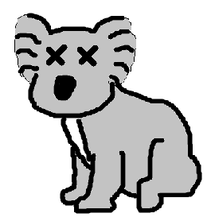
GAME OVER!
Eucalyptus too Toxic!
The Koala is now Extinct!
Play Again?

